Slide 1

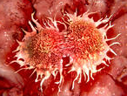
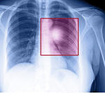

Brintelli Knowledge Tranfer
sHOULD smes TRANSFER bioTECHNOLOGY from Brazil TO THE uk?
PRESENTATION Inspired in THE research FINDINGS OF Janaina Pinto.
MA by Research in law (finance law) / Queen Mary university of London.

Slide 2
THINGS WHICH YOU NEED TO KNOW
SMEs in Brazil are much smaller than SMEs in the UK owing to exchange rate and regulations.
‘Patent is a set of exclusive rights granted by a State to an individual for a limited period of time in exchange for detailed public disclosure of his intellectual property.’ (Definition from Wikipedia)
This presentation is about small companies in Brazil with big technologies and patents.

Slide 3
THE BACK BONE OF THIS PRESENTATION.
In terms of tech transfer, it is not the size of an SME that matters or how many people it employs. What really matters from a biotech transfer perspective is the quality of the technology and who invented it.
Patents generaly allow for an increase in the value of biotechnologies, even when the patent is still pending.

Slide 4
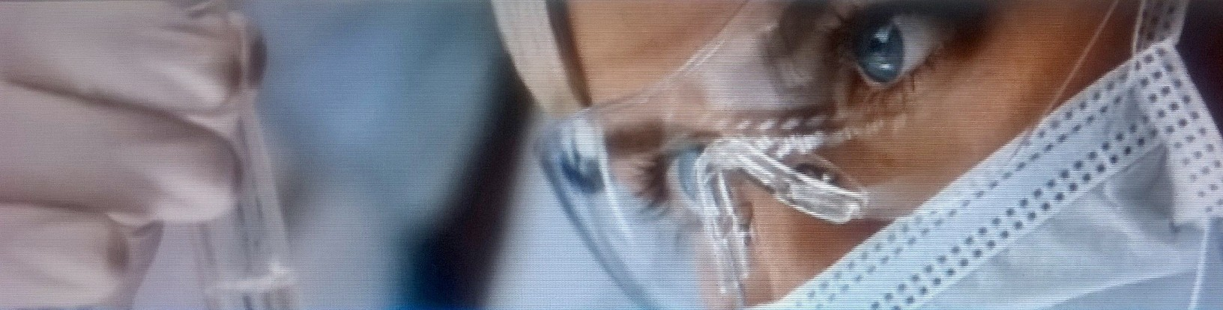
“ Should SMEs transfer biotechnology from Brazil to the UK?”
The answer is:
Yes, for strategic reasons a few SMEs can and should transfer technology from Brazil to the UK.
Comment
There is indication that the Scottish would make excellent business partners to biotech businesses from SP and MG.
Reality bite
Many Brazilian bio SMEs are not in a position to transfer technology from Brazil to the UK owing to IP reasons, plus lack of manuals, not enough patents, low cash flow, etc...

Slide 5
Brazilian SMEs: biotech scenario based on IP deposits. (INPI data)
#of good biotech SMEs in BR to 2015 (Total= 250)
#of SMEs which could be transferring biotech to the UK by 2018, provided that they receive strategic IP help/support from the government(s)
#of SMEs which are in a position to transferring relevant biotech to the UK
(Total= few)
#of SMEs which might be in a position to transferring relevant biotech from Brazil to the UK in the year 2023.
(Data not yet known)
70%+ agribusiness &bio fuel tech
São Paulo and
Minas Gerais are the two biggest players in biotech.

Slide 6
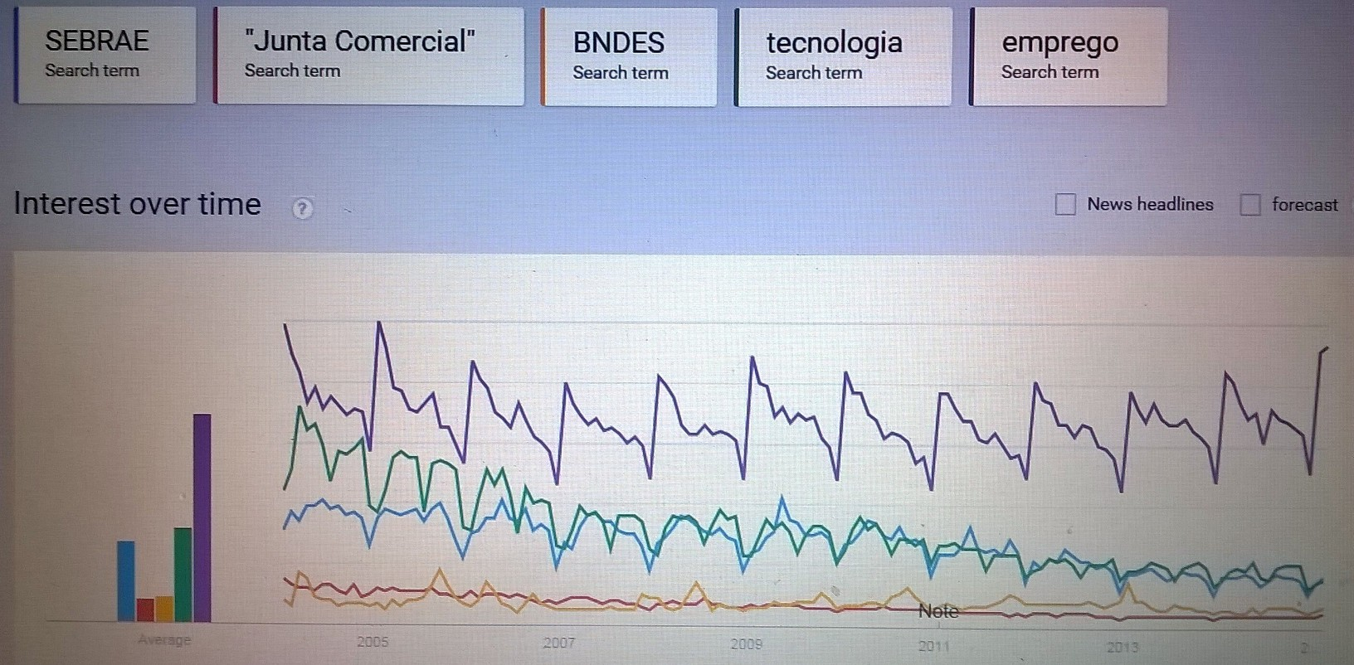
The gap between the number of people looking to start-up in business in Brazil and the number of people looking for employment is huge, which suggests that the conditions for SMEs businesses are not so good in Brazil.
(Data source: Google Trend)

Slide 7
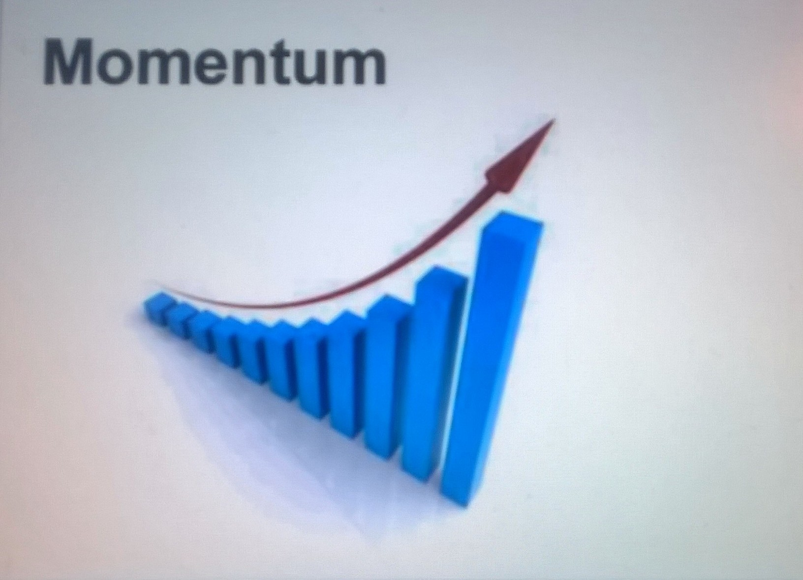
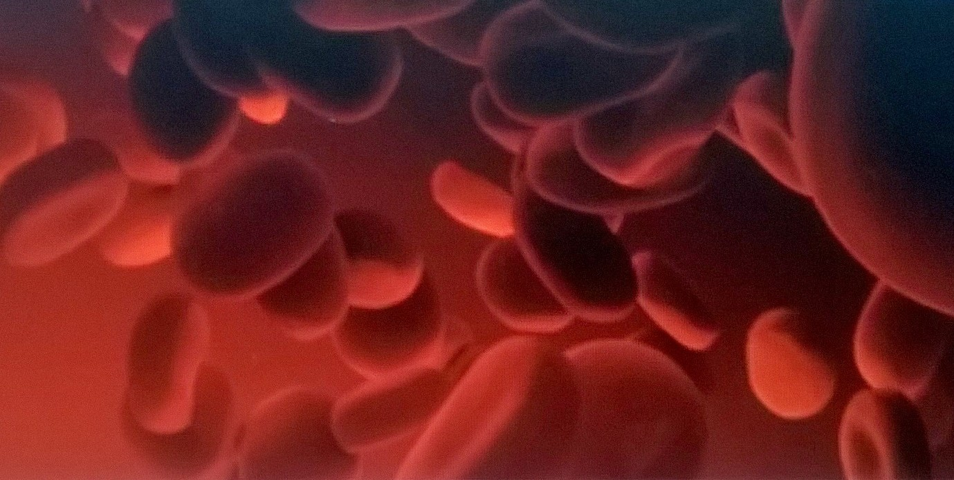
IT IS TIME TO MAKE AN EFFORT.
Tech transfer is strategic to any country where there are good universities, a Patent Office & technologies. Conditions are now good for tech transfers to happen from Brazil to the UK which can benefit both countries.

Slide 8
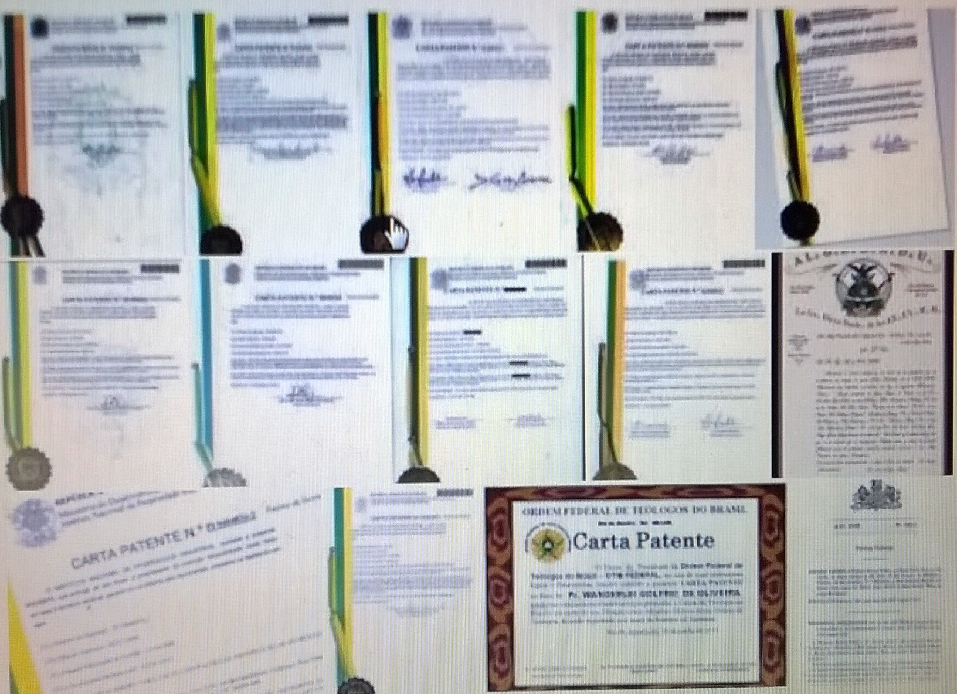
Life science patents have been granted to inventors in SP, MG, RJ, RS, PR.

Slide 9
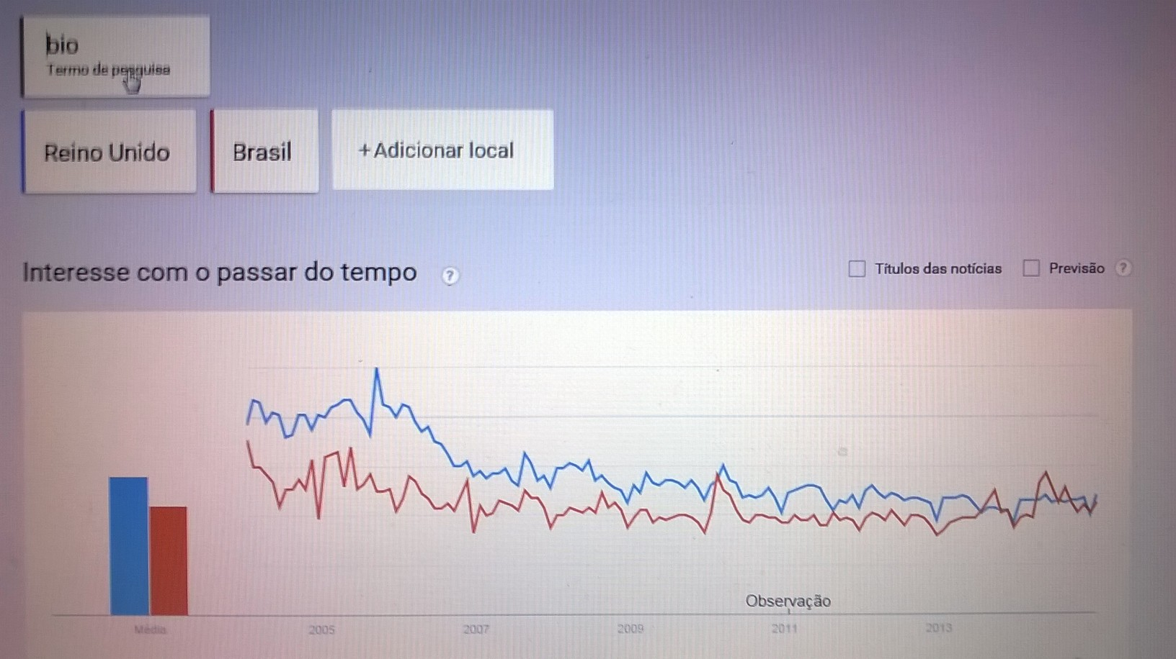
WHY TRANSFER BIOTECH FROM BRAZIL TO THE UK?

Slide 10
Overview of a potential Scottish-Brazilian-English alliance in biotech.
Common weaknesses of the Scottish + Brazilians;
The number of granted patents is less then desirable, considering all the publication efforts.
Several patent applications fail when the claims are examined by the Patent Offices.
Human capital is not exploit effectively enough.
A percentage of STEM graduates do not find employment in high- tech sectors.
Not enough biotech SMEs in Brazil or in Scotland.
Some key words which translate the combined strengths (in life sciences) of a potential Scottish + Brazilian biotech alliance;
agriculture;
biochemistry;
Immunology and immunomodulation;
protein studies;
Insectology;
Cancer;
genomics ;
Proteomics;
Proteogenomics
Biomakers
Chemistry
Nanocapsules
Key strengths which the English have to offer to the Brazilians;
State of the art technology & equipments; high ethics in doing business; holistic approach to making regulations; common law - which results in less red tape compared to the civil law; the Alternative Investment Market of the LSE.

Slide 11
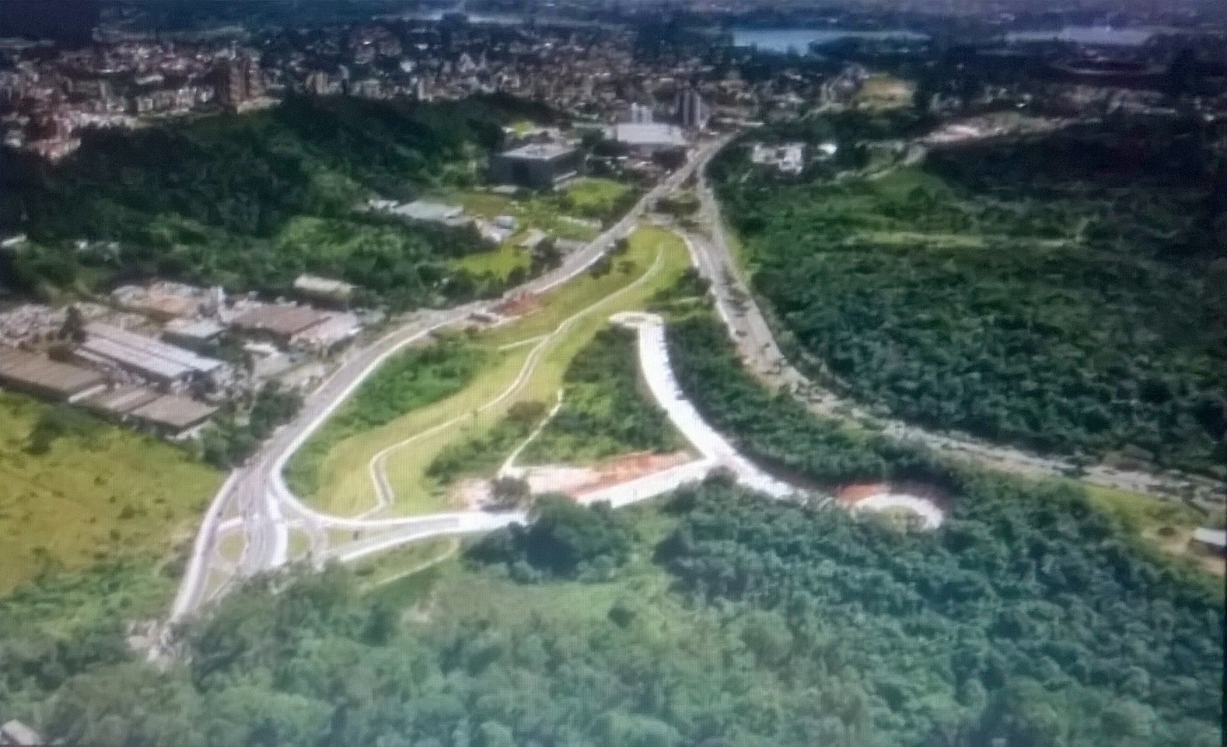
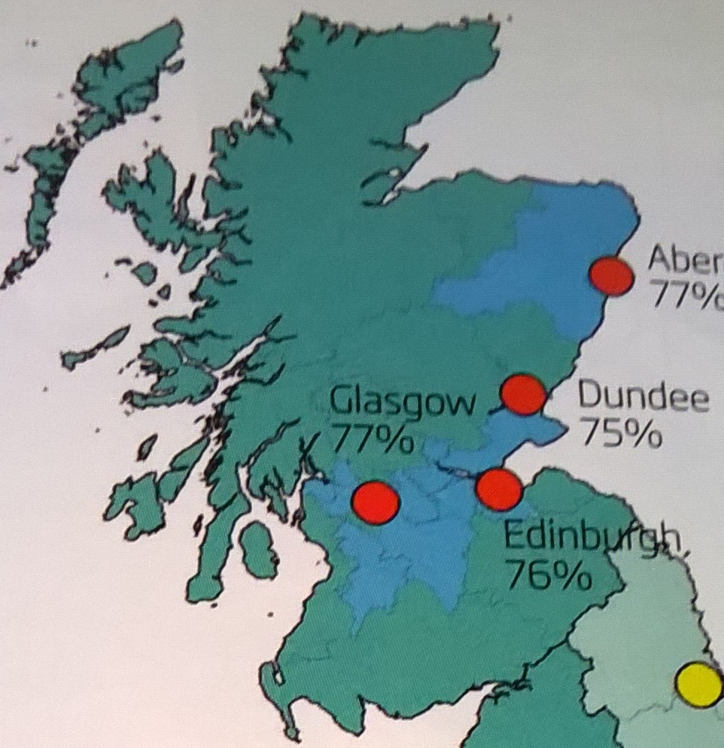
Brazilian biotech in Scotland can work!

Slide 12
MORE SMES ARE NEEDED TO TRANSFER TECH FROM BRAZIL TO UK.
Brazil needs more entrepreneurs and more SMEs.
Company directors like;
- STEM graduates who speak English and who are stuck in Brazil, owing to red tape known as “obligatory period in Brazil”.
- Top scientists who can utilise the Brazilian innovation law to spin-off technologies, but prefer to stay in the comfort zone of their labs, instead of starting up a business in Brazil or in the UK.

Slide 13

Will YOU BE A HERO FOR BRAZIL & START-UP A BIOTECH BUSINESS?
Start-up a SME today. Become an EIRELI company.
License your biotechnology to the UK, Brazil, etc.
Advance your career and get paid royalties for up to 20 years.

Slide 14
Brintelli Knowledge Tranfer – www.brintelli.com
Why is it interesting to transfer biotech to the UK?
Advantages for the Brazilians;
- Brazilians can transfer intangible assets (biotech) to the UK where the new industrialised products could gain access to new markets and customers in USA, Europe, etc.
Opportunities to apply to multiple R&D grants in Brazil and in the UK. (Perhaps even spin-offs; if one considers the programme called Start-up Brazil which accepts some UK applicants.)
Fast track to patents which can be granted by the UK Patent Office instead of INPI.
Potential to developing new technologies much faster than before.

Slide 15
Brintelli Knowledge Tranfer – www.brintelli.com
More advantages for the Brazilians;
Gain of knowledge in terms of how to write proper tech manuals and patents.
Payment of royalties by the British, allowing for an increase in cash flow which could pay for the annuity fees of several patents.
Access to the Junior Market of the London Stock Exchange.
Perhaps less dependency to the American financial rules and regulations.

Slide 16
Brintelli Knowledge Tranfer – www.brintelli.com
Why is it interesting to foster Brazilian biotech in the UK?
Initial advantages for the British:
1) Access to top-notch Brazilian biotechnology.
2) Access to the gatekeepers of the richest biodiversity in the world which is full of exotic chemical compounds. (Perhaps a step forward in terms of developing state of the art biologics).
3) A few British individuals would have the chance to become managing directors of biotech companies which would otherwise never exist, if not for the Brazilians.
4) More taxes to the HMR&C.

Slide 17
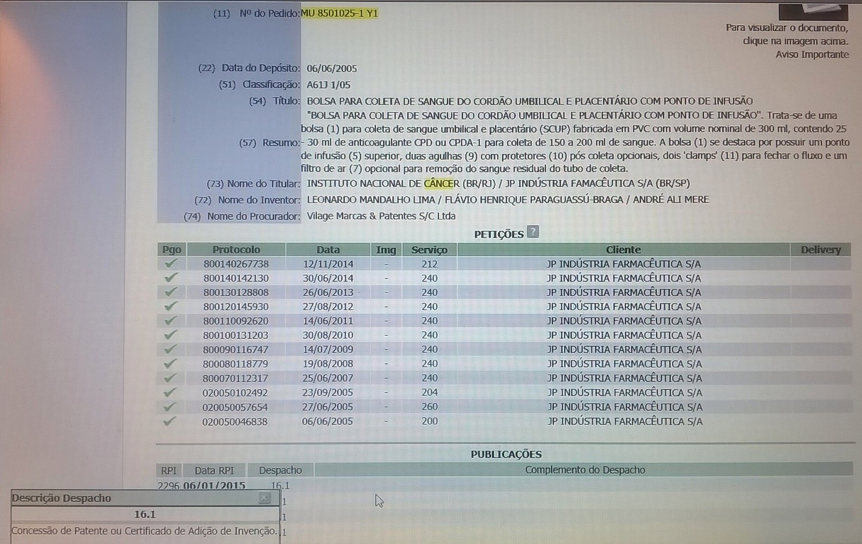
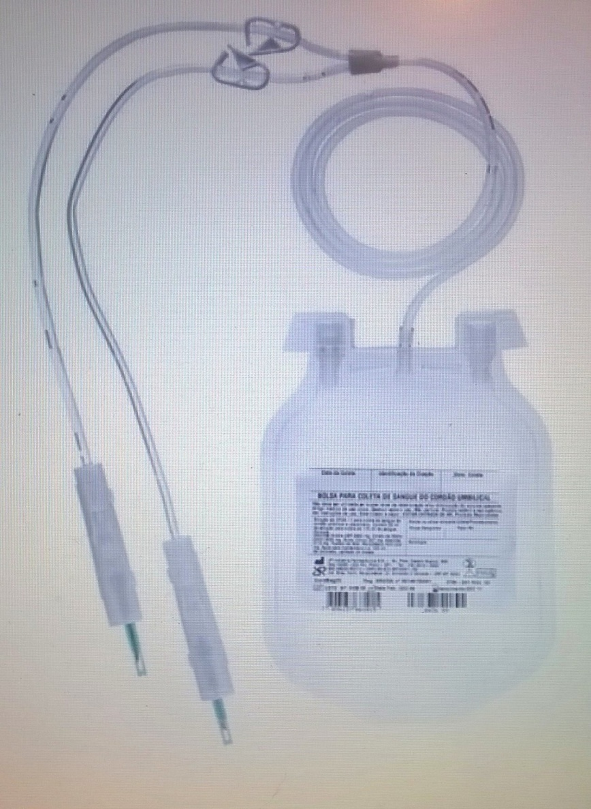
Patent granted product

Slide 18
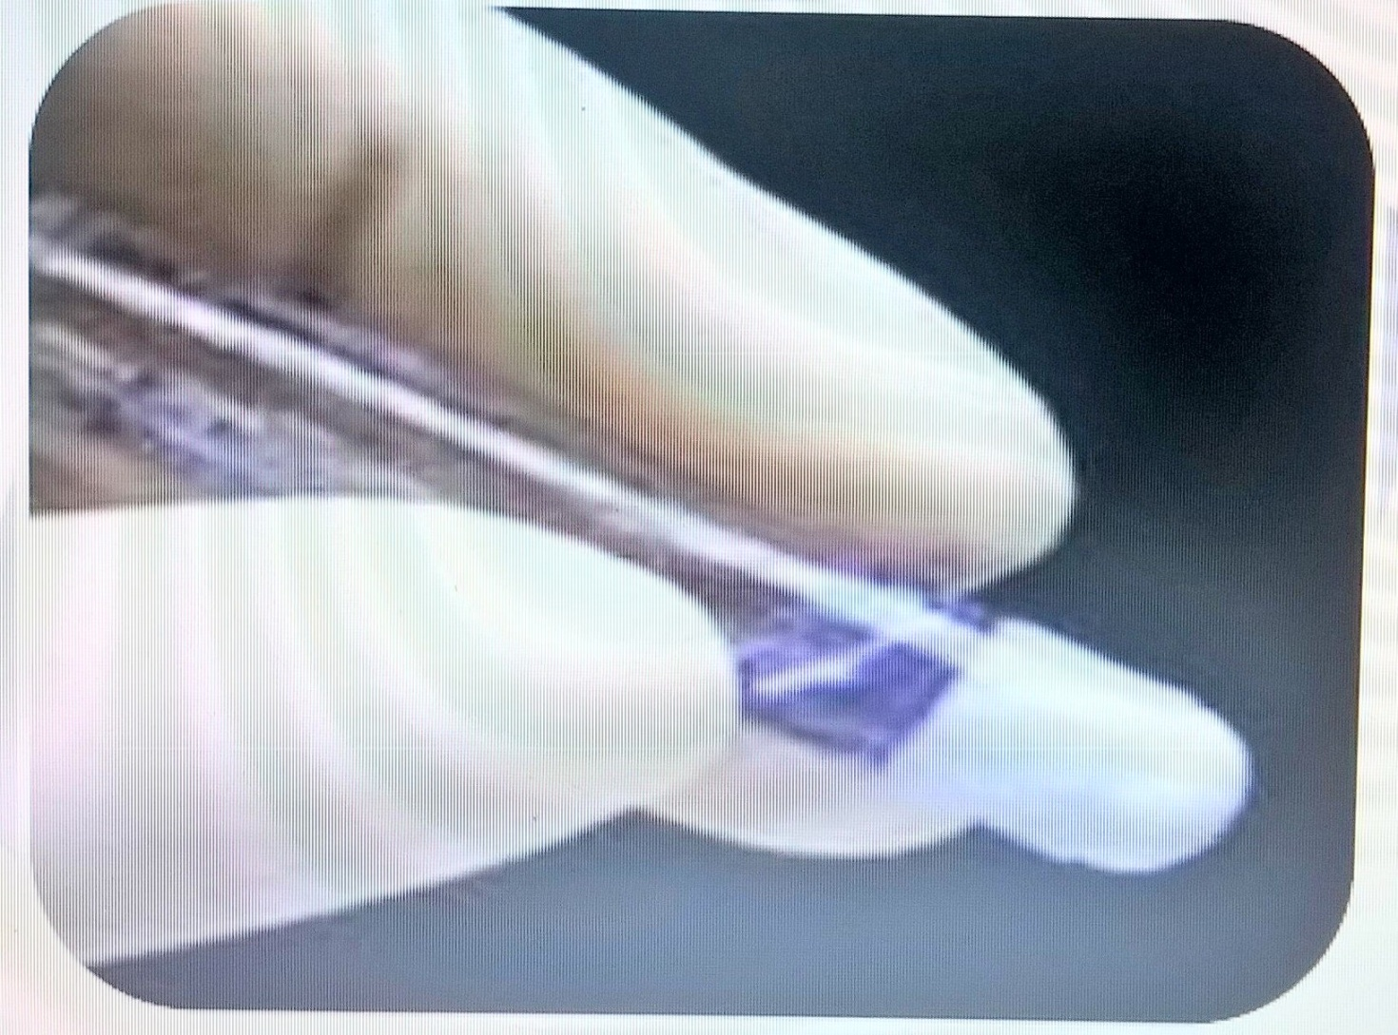
Patent pending surgical glue

Slide 19
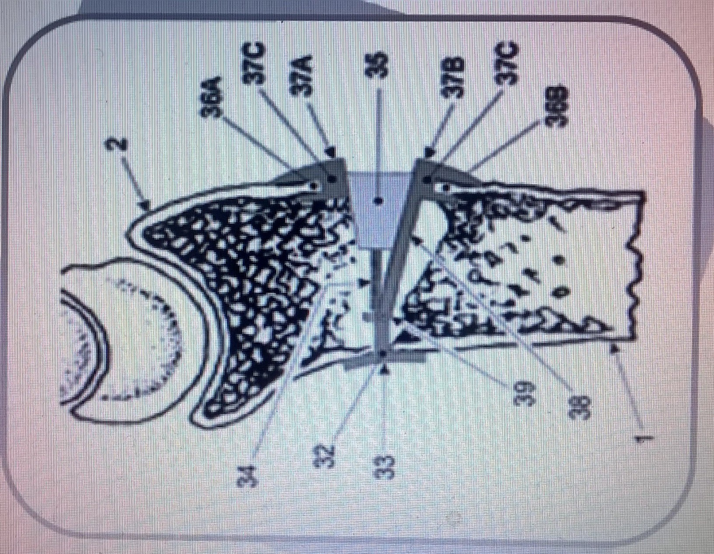
Patent pending “Bone prosthetics”

Slide 20
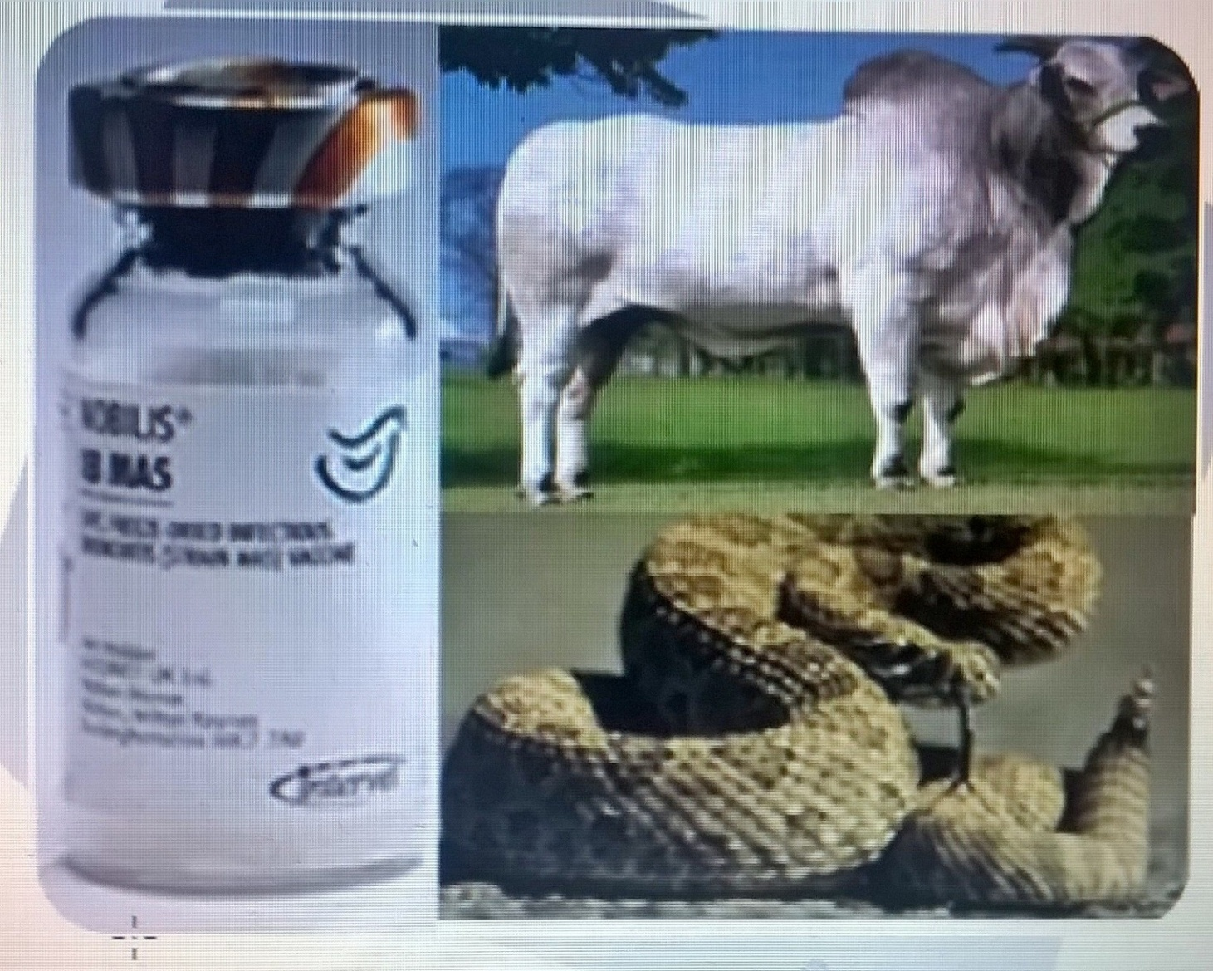
Patent pending vaccine

Slide 21
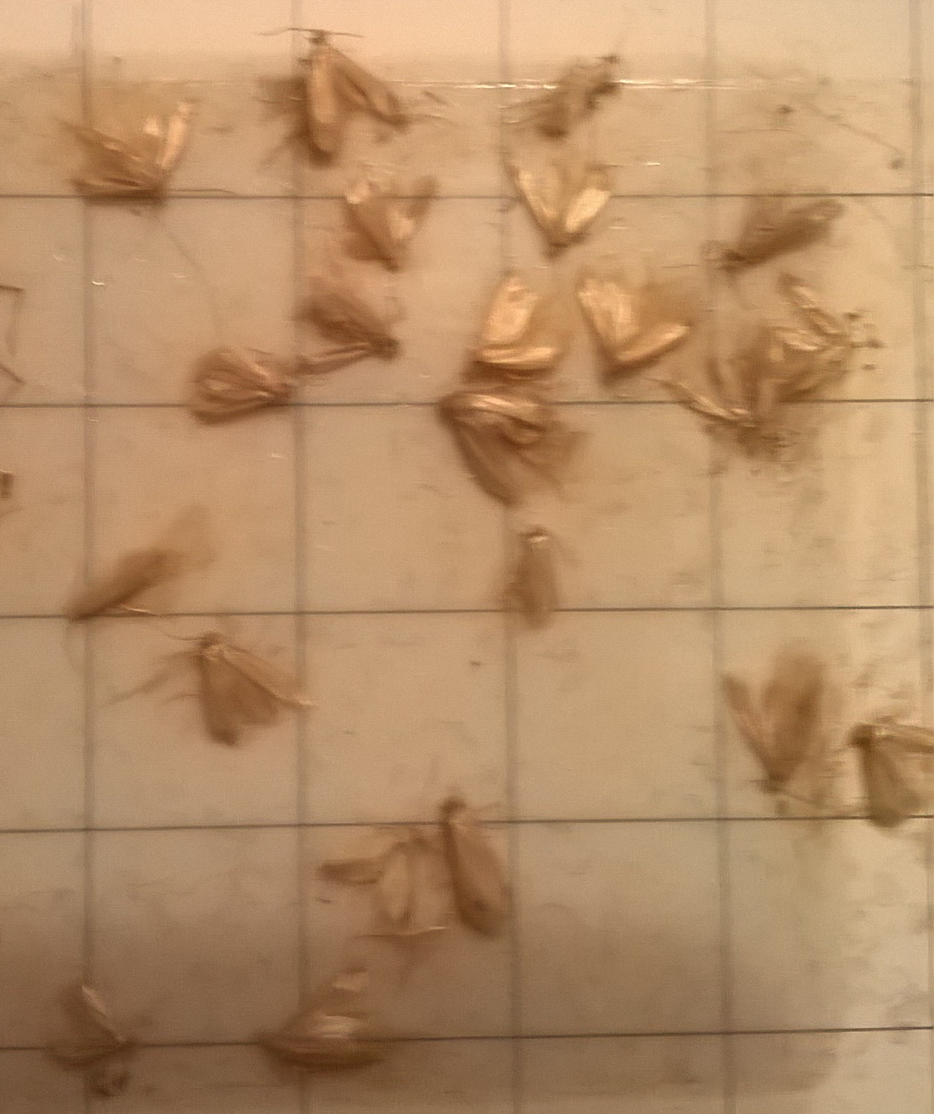
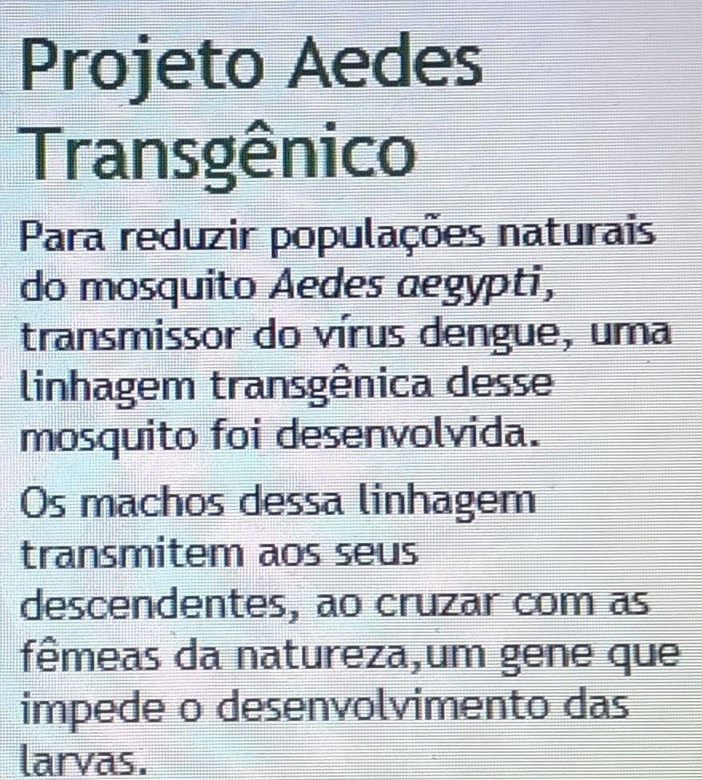
Perhaps the Brazilians could make a transgenic male of this pest below;

Slide 22
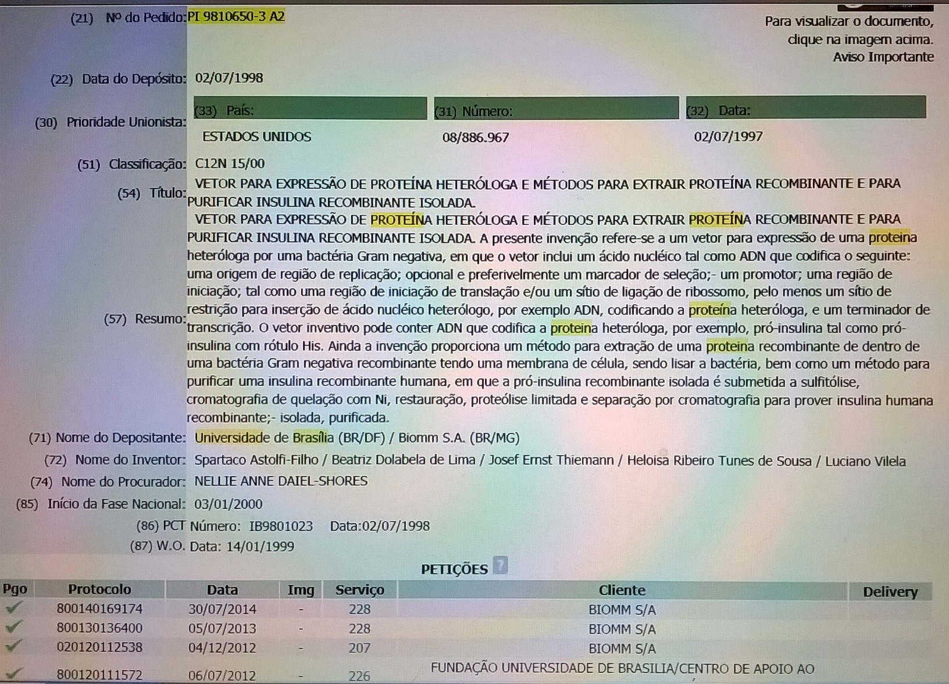
See the official patent title of BIOMM’s recombinant insuline product

Slide 23
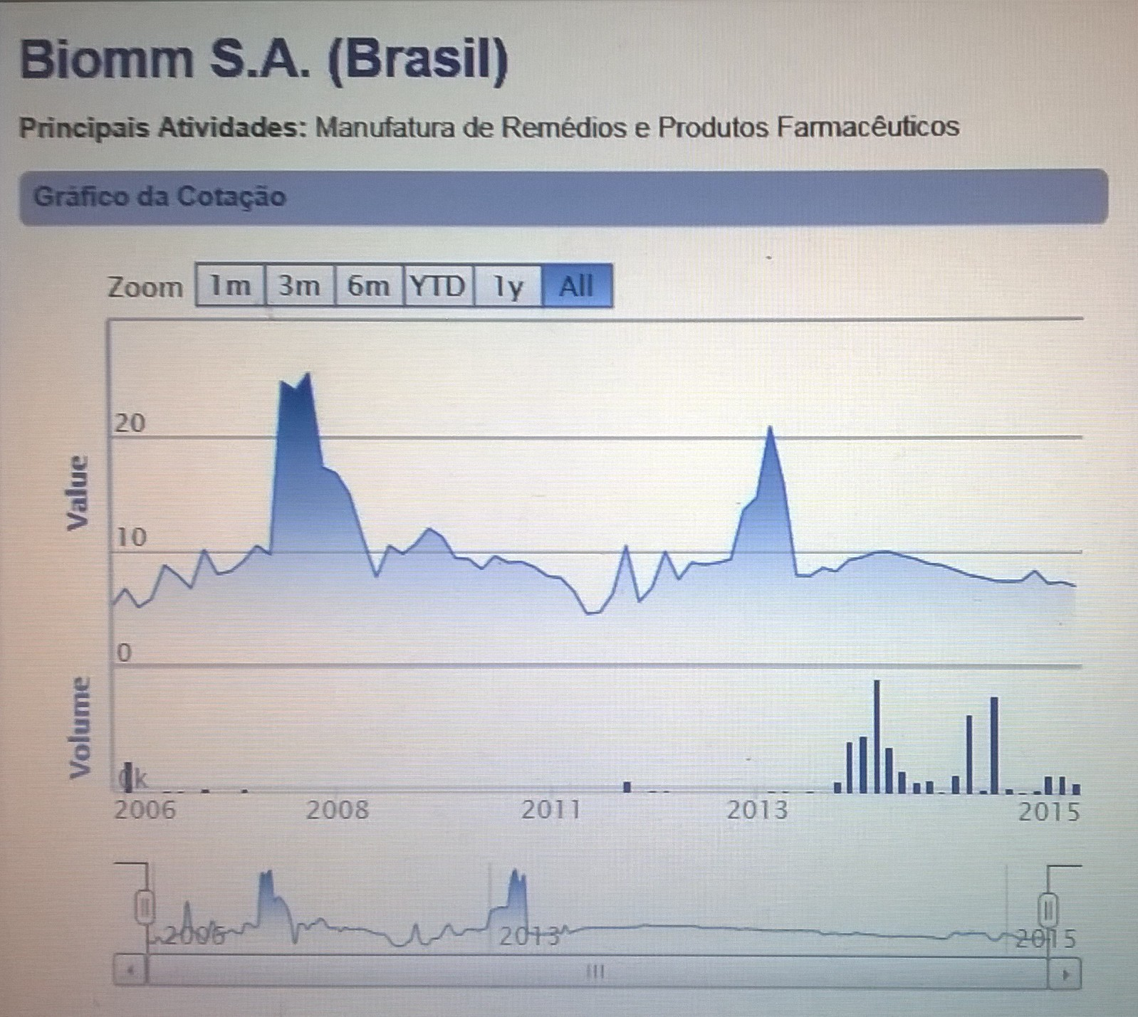
Brintelli Knowledge Tranfer

Slide 24
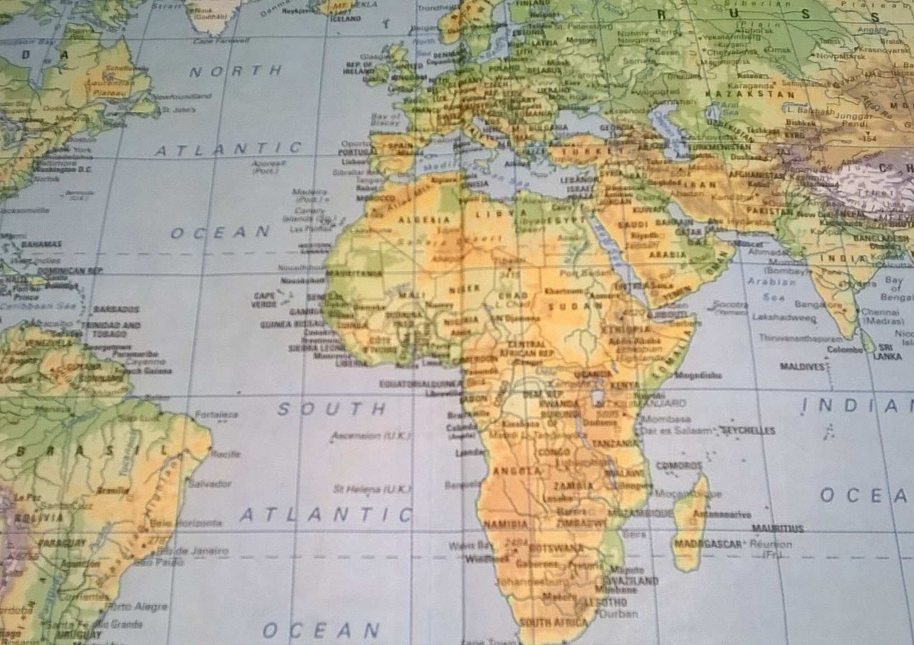
The goal is to grow SMEs which can reach the AIM & export 2the world.

Slide 25
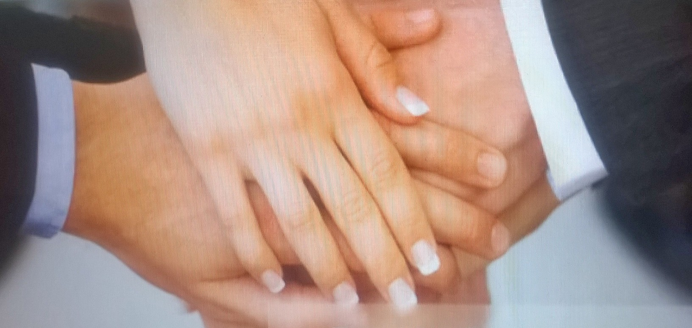
CAN WE (BRAZILIAN/BRITISH) MAKE IT HAPPEN?

Slide 26
CONCLUSION
Intellectual property transfers from Brazil to the UK could improve and increase the financial ties between the two countries in the long term.
Technologies which are patented just in Brazil are not utilising their full potential in terms of generating new businesses.

Slide 27
Brintelli Knowledge Tranfer
Intellectual Property Disclaimer
This presentation is for research purposes only.
Data collected in Feb/2015 from;
Google Trends – www.google.com/trends
http://www.securities.com/
http://inventta.net
http://www.inpi.gov.br

Slide 28

Brintelli Knowledge Tranfer www.brintelli.com
Janaina Portugal Pinto
Director & researcher at
Brintelli Knowledge Transfer Ltd
www.tecnologiaindustrial.com.br
info@brintelli.com
+44 203 290 9307
My Tech Transfer Certificates
East Meets West on innovation &entrepreneurship (Sep 2012; University of Cyprus - Nicosia)
Production Engineering (May 2008; IETEC, Belo Horizonte)
XV Workshop Anprotec on Innovation Tax Law (Sep 2007, BH)
Conhecimento Avançado em Franchising – ABF.
Conectar – Seminário de Inovação e Transferências de Tecnologias
Campinas Inova 2005 Inovação, Comercialização e Transferência de Tecnologia, uma perspectiva global.
Escolhendo empresas para investir (Nov 2005, INI)
Iniciando um pequeno grande negócio (Aug 2005, SEBRAE)
Programa de Treinamento para Capacitar Gestores da Cooperação Empresa – Universidade & Institutos de Pesquisa – PROTEU VII.
Campinas Inova 2004, Transferência de Tecnologia, Direitos de Proprieade Intelectual e Política Empresarial.
XII – Simpósio de gestão da inovação tecnológica (Oct 2004, Curitiba)
Gestão de Conhecimento – Associação Brasileira das Instituições de Pesquisa Tecnológica (Nov 2002).
Bolsa de gestão em ciência e tecnologia FAPEMIG – BGCT III – para criação de unidade institucional para gestão tecnológica e proteção ao conhecimento do CETEC.
Fórum técnico de Biotecnologia (Sep 2002, Assembléia Legislativa de Minas Gerais.)

